Slide 1

Travel Insurance

Slide 2
Introduction
In an era marked by dynamic global travel, effective risk management is paramount for organizations.
Recognizing the need for informed decision-making, our management seeks to enhance their understanding of travel insurance dynamics.
This project aims to provide a comprehensive guide for management, leveraging a dataset of 63,326 raw records, to estimate insurance rates based on destinations and coverage types.

Slide 3
Abstract
With a dataset encompassing 63,326 records of raw data, our focus revolves around developing a guide that serves as a compass for management in the realm of travel insurance.
Addressing questions such as the typical customer profile, destinations with the highest insurance claims, popular product plans in Q2, and the influence of travel duration on claims, we delve into the realm of data-driven decision-making.

Slide 4
Objective
The primary objective of this initiative is to empower management with a robust tool that allows them to gain insights into insurance travel information.
By addressing specific queries posed by management and extracting valuable patterns from the dataset, the project aims to assist in understanding customer profiles, identifying high-risk destinations, analyzing product plan preferences, and evaluating the impact of travel duration on insurance claims.

Slide 5

Real World Impact

Slide 6
Here are several potential real-world impacts:
Informed Decision-Making:
With a comprehensive guide derived from data-driven insights, management can make well-informed decisions regarding travel insurance. This, in turn, minimizes uncertainties and equips organizations to tailor insurance plans that align with the specific needs and preferences of their clientele.
Cost Optimization:
Accurate estimation of insurance rates based on destinations and coverage types enables organizations to optimize costs. By identifying patterns and trends, management can strategically allocate resources, ensuring they offer competitive insurance plans without compromising financial sustainability.
Customer-Centric Approach:
Understanding the typical customer profile and preferred product plans allows businesses to adopt a more customer-centric approach. This insight enables the customization of insurance offerings, enhancing customer satisfaction and loyalty.

Slide 7
Risk Mitigation:
The identification of high-risk destinations and an analysis of the impact of travel duration on insurance claims contribute to effective risk mitigation strategies. Organizations can proactively address potential challenges, reducing the likelihood of claims and associated financial implications.
Strategic Planning:
With a clear understanding of the dynamics influencing insurance claims, management can engage in strategic planning. This involves aligning business goals with the insights derived from the dataset, fostering long-term sustainability and resilience in an ever-evolving global travel landscape.
Adaptation to Trends:
The ability to discern positive and negative trends equips organizations with the agility to adapt and evolve. By staying ahead of market dynamics, businesses can respond effectively to changing customer behaviors, industry shifts, and emerging risks.

Slide 8
Dataset Travel Insurance
Which contained the following data:
Target: Claim Status (Claim.Status)
Name of agency (Agency)
Type of travel insurance agencies (Agency.Type)
Distribution channel of travel insurance agencies (Distribution.Channel)
Name of the travel insurance products (Product.Name)
Duration of travel (Duration)
Destination of travel (Destination)
Amount of sales of travel insurance policies (Net.Sales)
Commission received for travel insurance agency (Commission)
Gender of insured (Gender)
Age of insured (Age)
https://www.kaggle.com/datasets/mhdzahier/travel-insurance/data

Slide 9
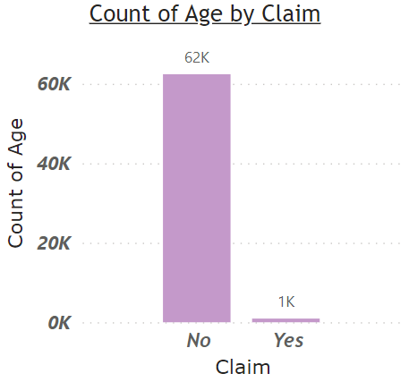
Target Variable

Slide 10
Metric selection and Reasoning
Precision and Recall: Precision measures the proportion of true positive predictions out of all positive predictions, while recall measures the proportion of true positive predictions out of all actual positive cases. These metrics are particularly important if the business wants to balance the need to minimize false positives (approving bad loans) and false negatives (rejecting good loans).
F1 Score: The F1 score is the harmonic mean of precision and recall and provides a balanced measure of a model's performance. It can be useful when there is an uneven distribution between positive and negative cases in the dataset.
ROC Curve and AUC: Receiver Operating Characteristic (ROC) curve and Area Under the Curve (AUC) measure the model's ability to discriminate between good and bad credit risks across different decision thresholds. A high AUC indicates good model performance.

Slide 11
Solution Approach and Problem Type
There are multiple ways in which these are handled to name a few are :
1. LogisticRegression
2. KNeighborsClassifier
3. DecisionTreeClassifier
4. RandomForest Classifier
5. Support Vector Classification (SVC)
6. Naive Bayes
7. xgboost
8. Stochastic gradient descent
9. LinearSVC
10. MultinomialNB
11. Extra Trees Classifier
12. Gradient Boosting Classifier

Slide 12

Libraries
import numpy as np
import pandas as pd
import matplotlib.pyplot as plt
import seaborn as sns
Description of these libraries are as follows:-
Pandas for Dataframe operations
Numpy for Numeric operations
Matplotlib and Seaborn are Data Visualisation libraries

Slide 13
Visualization

Slide 14
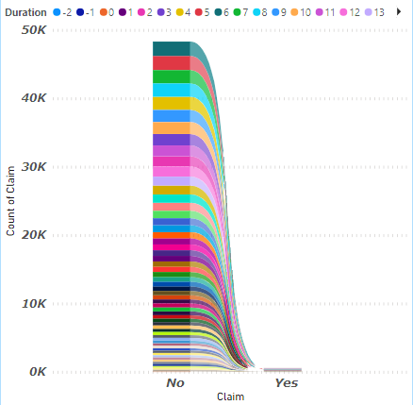
Count of Claim by Duration

Slide 15
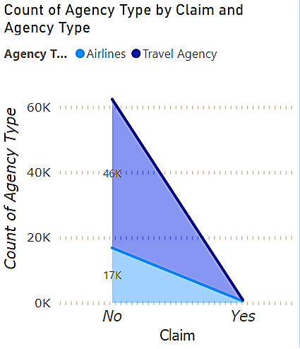
Count of resting blood pressure (trestbps)

Slide 16
Modeling

Slide 17
Standardize the features
from sklearn.preprocessing import StandardScaler
scaler = StandardScaler()
X_train_scaled = scaler.fit_transform(X_train)
X_test_scaled = scaler.transform(X_test)

Slide 18
Splitting the dataset in to train and test
Module used:
from sklearn.model_selection import train_test_split
X = df.drop(['Claim'], axis=1).values
y = df['Claim'].values
X_train, X_test, y_train, y_test = train_test_split(X, y, test_size=0.2, random_state=42)

Slide 19
Models used to predict :
0. Gradient Boosting Classifier
1. LogisticRegression
2. KNeighborsClassifier
3. DecisionTreeClassifier
4. RandomForest Classifier
5. Support Vector Classification (SVC)
6. Naive Bayes
7. xgboost
8. Stochastic gradient descent
9. LinearSVC
10. MultinomialNB
11. Extra Trees Classifier

Slide 20
from sklearn.model_selection import train_test_split
from sklearn.ensemble import GradientBoostingClassifier
from sklearn.model_selection import train_test_split
from sklearn.metrics import accuracy_score
from sklearn.linear_model import LogisticRegression,SGDClassifier
from sklearn.neighbors import KNeighborsClassifier
from sklearn.tree import DecisionTreeRegressor
from sklearn.tree import DecisionTreeClassifier
from sklearn.ensemble import RandomForestClassifier,ExtraTreesClassifier
from sklearn.metrics import accuracy_score,f1_score
from sklearn.svm import SVC,LinearSVC
from sklearn.naive_bayes import GaussianNB,BernoulliNB
from sklearn.metrics import accuracy_score, confusion_matrix, classification_report, fbeta_score
import xgboost as xgb
Libraries
for
Modeling

Slide 21
SMOTE
from imblearn.over_sampling import SMOTE
oversampler = SMOTE()
X, y = oversampler.fit_resample(X_train, y_train)

Slide 22
Creating models
models=[0]*12
models[0] = LogisticRegression()
models[1] = KNeighborsClassifier()
models[2] = DecisionTreeClassifier()
models[3] = RandomForestClassifier()
models[4] = ExtraTreesClassifier()
models[5] = SVC()
models[6] = GaussianNB()
models[7] = xgb.XGBClassifier()
models[8] = SGDClassifier()
models[9] = LinearSVC()
models[10] = BernoulliNB()
models[11] = ExtraTreesClassifier()

Slide 23
def check():
for m in models:
model=m
model.fit(X_train,y_train)
y_pred = model.predict(X_test)
print('Model Name: ',m)
print("Accuracy score is: ",accuracy_score(y_test,y_pred)*100)
print(confusion_matrix(y_test, y_pred))
print(classification_report(y_test, y_pred))
print()

Slide 24
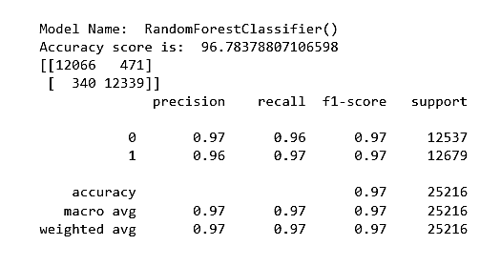
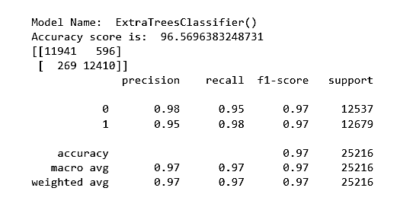
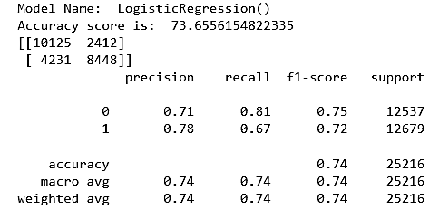
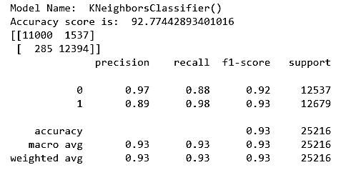
Precision, recall, support,f1-score, and accuracy of each model

Slide 25
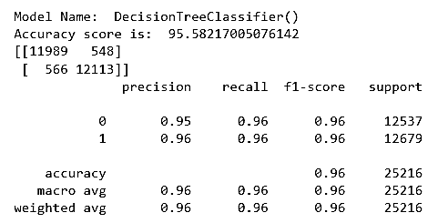
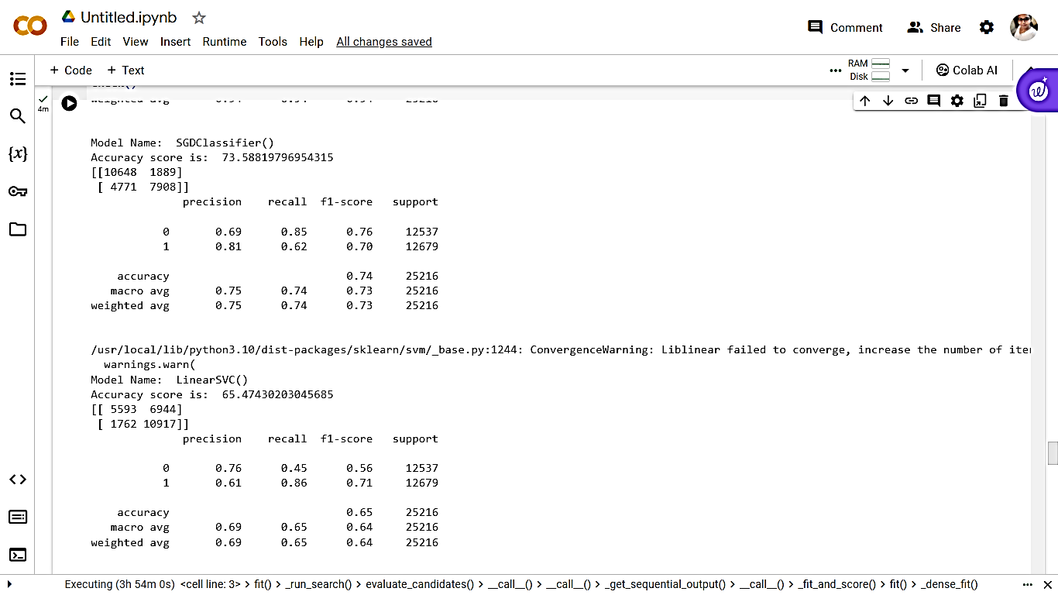
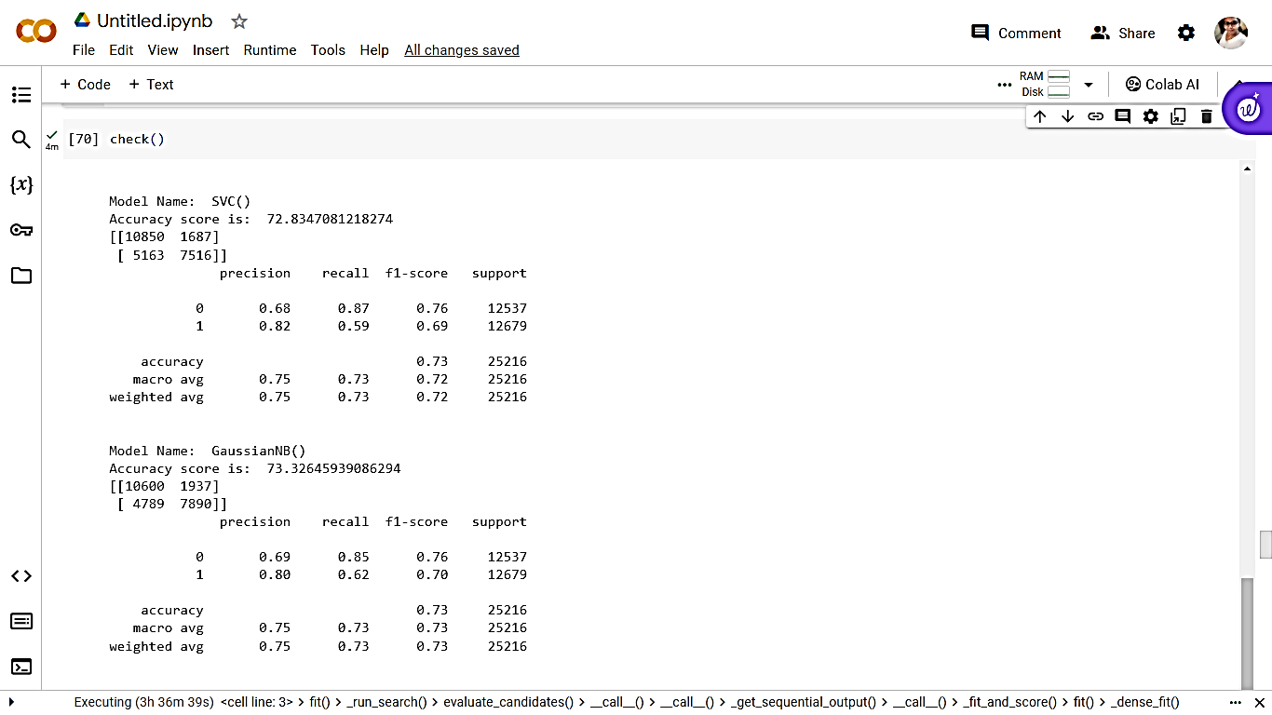
Precision, recall, support,f1-score, and accuracy of each model

Slide 26
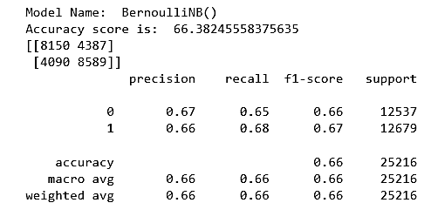
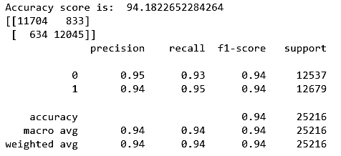
Precision, recall, support,f1-score, and accuracy of each model
Model Name: XGBClassifier

Slide 27
So we get the highest accuracy score that is 96.78 and 96.56 in Random Forest and ExtraTreesClassifier respectively and also has the highest f1 score, precision and recall

Slide 28
Cross Validation
from sklearn.model_selection import cross_val_score
for m in models:
scores = cross_val_score(m, X_train, y_train, cv=10)*100
print('Model Name: ',m)
print('Cross-Validation Accuracy Scores', scores)
print()

Slide 29
After Cross validation we get the highest valued model as:
Model Name: RandomForestClassifier() Cross-Validation Accuracy Scores [96.87287559 96.54996601 96.68592794 96.56696125 96.53297077 96.60095173 96.88934217 96.26041135 96.61737209 96.36240014] Model
Name: ExtraTreesClassifier() Cross-Validation Accuracy Scores [96.80489463 96.24405167 96.26104691 96.07409925 96.4649898 96.48198504 96.32840388 96.02243753 96.26041135 95.76746558]

Slide 30
Hyperparameter tuning
Define hyperparameter grids for each model
best_models = [0] * 12
param_grid = {
0: {'C': [0.001, 0.01, 0.1, 1, 10, 100]},
1: {'n_neighbors': [3, 5, 7, 9]},
2: {'max_depth': [None, 10, 20, 30]},
3: {'n_estimators': [50, 100, 200], 'max_depth': [None, 10, 20, 30]},
4: {'n_estimators': [50, 100, 200], 'max_depth': [None, 10, 20, 30]},
5: {'C': [0.001, 0.01, 0.1, 1, 10, 100], 'gamma': ['scale', 'auto'], 'kernel': ['linear', 'rbf']},
6: {},
7: {'n_estimators': [50, 100, 200], 'max_depth': [3, 5, 7]},
8: {'alpha': [0.0001, 0.001, 0.01, 0.1, 1, 10]},
9: {'C': [0.001, 0.01, 0.1, 1, 10, 100]},
10: {'alpha': [0.0001, 0.001, 0.01, 0.1, 1, 10]},
11: {'n_estimators': [50, 100, 200], 'max_depth': [None, 10, 20, 30]}
}

Slide 31
Perform hyper parameter tuning for each model
from sklearn.model_selection import GridSearchCV
for i in range(12):
model = models[i]
parameters = param_grid[i]
if i == 7:
model = xgb.XGBClassifier()
grid_search = GridSearchCV(model, parameters, scoring='accuracy', cv=5)
else:
grid_search = GridSearchCV(model, parameters, scoring='accuracy', cv=5)
grid_search.fit(X_train, y_train)
best_models[i] = grid_search.best_estimator_
print(f"Best parameters for Model {i}: {grid_search.best_params_}")
print(f"Best accuracy for Model {i}: {grid_search.best_score_}\n")

Slide 32
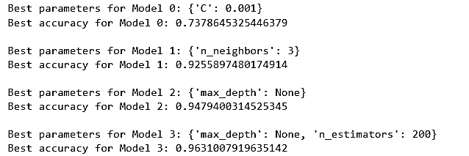
After hyper parameter tuning we get :

Slide 33
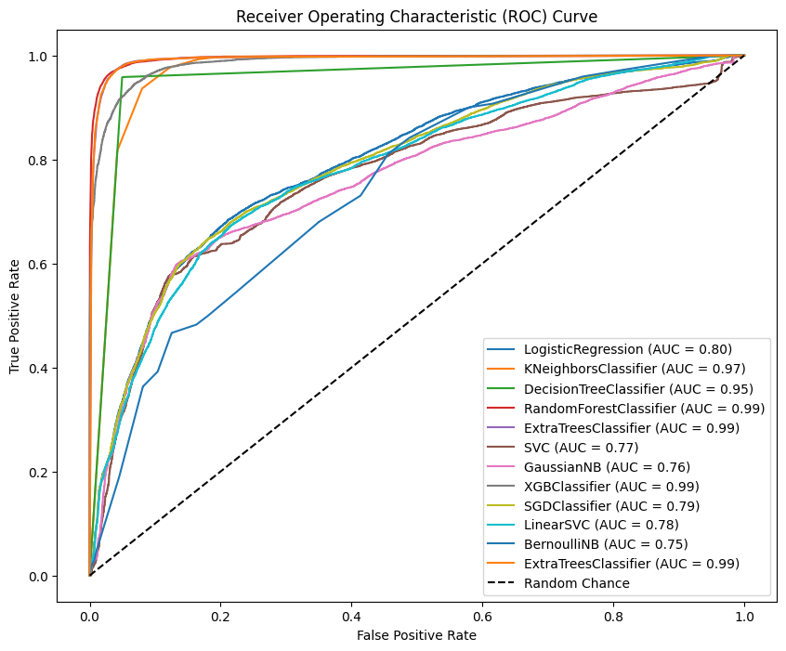

Slide 34
Conclusion
After conducting model training, cross-validation, testing, hyper parameter tuning, and analyzing the ROC curve, the Random Forest classifier emerged as the most suitable model.
The decision to proceed with it is based on its superior performance and ability to handle the given task effectively.
In summary, the recommendation to use the Random Forest classifier is grounded in a thorough analysis of its performance across various aspects of model development and evaluation.

Slide 35
Refrence:
https://www.kaggle.com/datasets/mhdzahier/travel-insurance/data

